Slide 1
Chapter 3 Lecture 1: Particles, droplets & bubbles 8 february 2021
Abstraction of chapter 3.1.1
Training exercise 3.1
Application

Slide 2
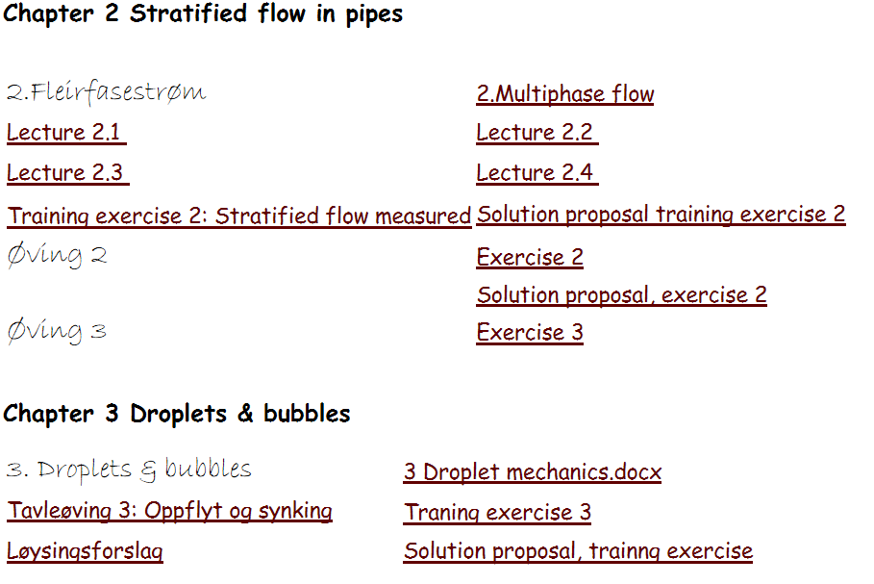
Schedule:

Slide 3
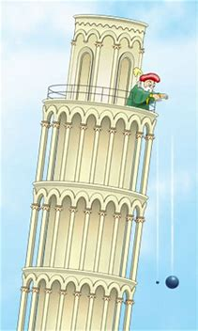
Sinking (falling)
Aristoteles: Heavier objects fall faster
Galilei’s Pisa tower experiment:

Slide 4
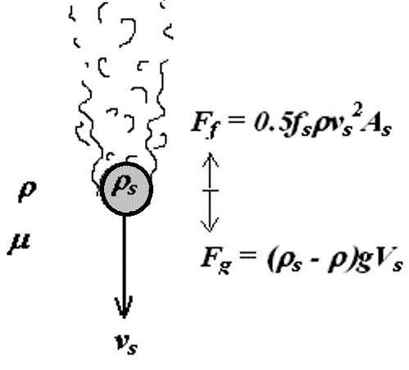
Sinking (falling) velocity of solid objects
Heavier objects: larger, or denser fall faster. Galileo was wrong.

Slide 5
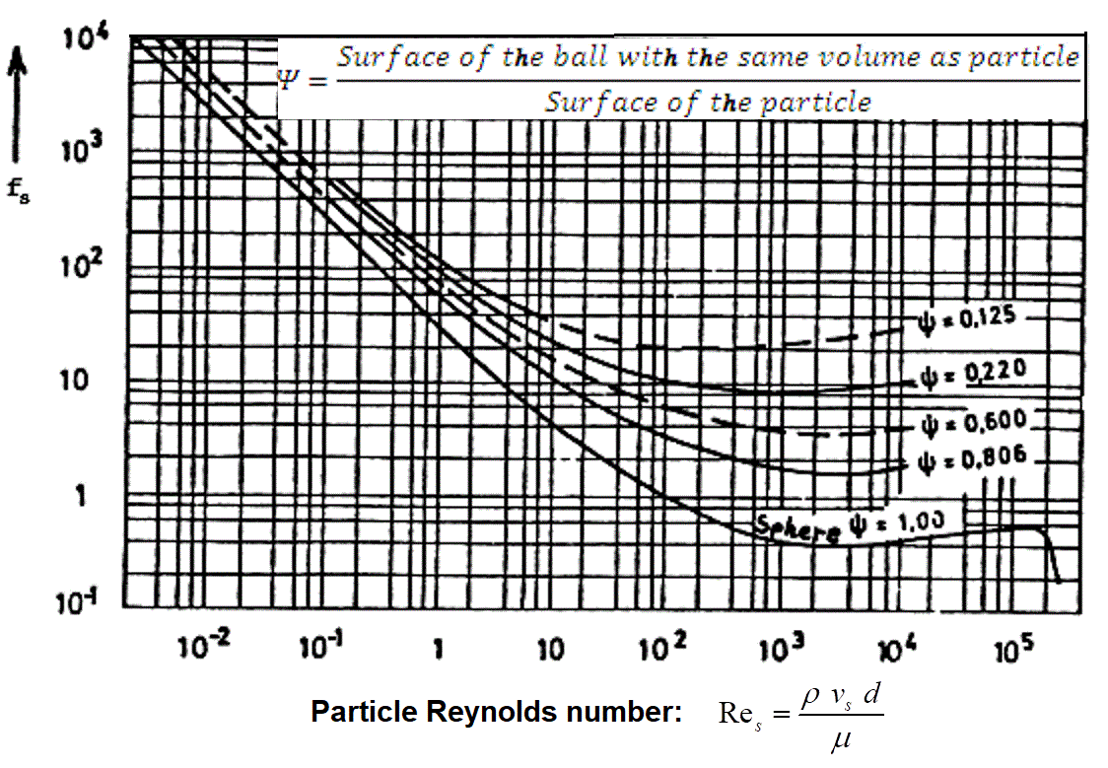
Sinking velocity of solid objects: Quantification
Stationary velocity→force balance:
Considering spheric particle (ball):
→

Slide 6
How to predict sinking velocity
Challenge: Sinking velocity depends on Reynolds number.
Solution: Iteration

Slide 7
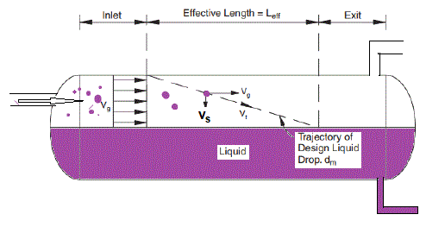
Application (particles/droplets of given size)
Sand management, sand accumulation (Training exercise 3.1)
Separator design (allowable size of escaping droplets droplet)

